Slide 1

Age gender and ethnicity prediction
Cmr institute of technology
(UGC AUTONOMUS, Approved by AICTE, New Delhi & Affiliated to JNTUH, Hyderabad)
Kandlakoya, Medchal Road, Hyderabad, Telangana – 501401.
An Industry-Oriented Mini Project Report
Batch - 10
UNDER THE GUIDANCE OF : MRS.A.TEJASWI
23R01A05K7
23R01A05L2
23R01A05P1

Slide 2
CONTENTS
ARCHITECTURE
MODULES
IMPLEMENTATION
SCREENSHOTS
TESTING
CONCLUSION
ABSTRACT
INTRODUCTION
LITERATURE SURVEY
SYSTEM ANALYSIS
SYSTEM STUDY
HARDWARE AND SOFTWARE REQUIREMENTS

Slide 3
ABSTRACT
This project focuses on the development of a system for predicting age, gender, and ethnicity from facial images using Artificial Intelligence and Computer Vision techniques. The system utilizes deep learning, specifically a Convolutional Neural Network (CNN), to automatically analyze facial features and generate accurate predictions.
The process begins with collecting a labeled dataset of facial images, followed by preprocessing steps such as face detection, resizing, and normalization to improve data quality. The processed images are then used to train the CNN model, which learns important patterns and features from the data. During testing, the trained model takes new facial images as input and predicts the corresponding age, gender, and ethnicity.

Slide 4
INTRODUCTION
Advancements in Artificial Intelligence and Computer Vision have made it possible for machines to analyze facial images and predict attributes such as age, gender, and ethnicity. Using deep learning techniques, systems can learn patterns from large datasets to perform these predictions accurately. This project focuses on building a model for demographic prediction while considering challenges like accuracy, bias, and privacy

Slide 5
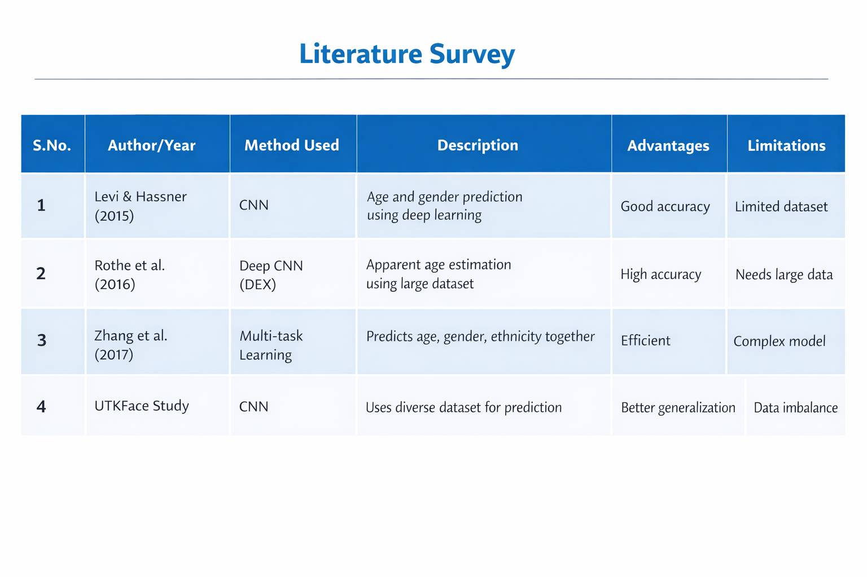
LITERATURE SURVEY

Slide 6
SYSTEM ANALYSIS
The system is designed to predict age, gender, and ethnicity from facial images using Artificial Intelligence and Computer Vision techniques. It takes an image as input, performs preprocessing such as face detection and normalization, and uses a deep learning model to generate predictions. The system aims to provide accurate and efficient results, but its performance depends on the quality of data and may be affected by factors like lighting, image clarity, and dataset bias.

Slide 7
Input: Facial image
Preprocessing: Face detection, resizing, normalization
Model: CNN-based deep learning model
Output: Predicted age, gender, and ethnicity
Requirements: Large labeled dataset, trained model
Constraints: Image quality, lighting conditions, dataset bias
Goal: Accurate and fast prediction system

Slide 8
SYSTEM STUDY
Understanding the existing system and concepts.The system study focuses on understanding how demographic prediction can be performed using Artificial Intelligence and Computer Vision. It analyzes the process of collecting facial image data, preprocessing it, and applying deep learning models for prediction. The study also examines existing methods, tools, and datasets used for age, gender, and ethnicity prediction, along with their advantages and limitations. This helps in designing an efficient system that provides accurate results while addressing challenges like bias and data quality.Initial stage of the project.

Slide 9
HARDWARE AND SOFTWARE REQUIREMENTS
Hardware Requirements
Computer/Laptop with good processing power
Minimum 4GB–8GB RAM
Storage (HDD/SSD) for datasets and models
GPU (optional, for faster training)
Camera (optional, for real-time input)

Slide 10
Software Requirements
Programming Language: Python
Libraries: TensorFlow / Keras / PyTorch
Image Processing: OpenCV
IDE: Jupyter Notebook / VS Code
Concepts based on Artificial Intelligence and Computer Vision

Slide 11
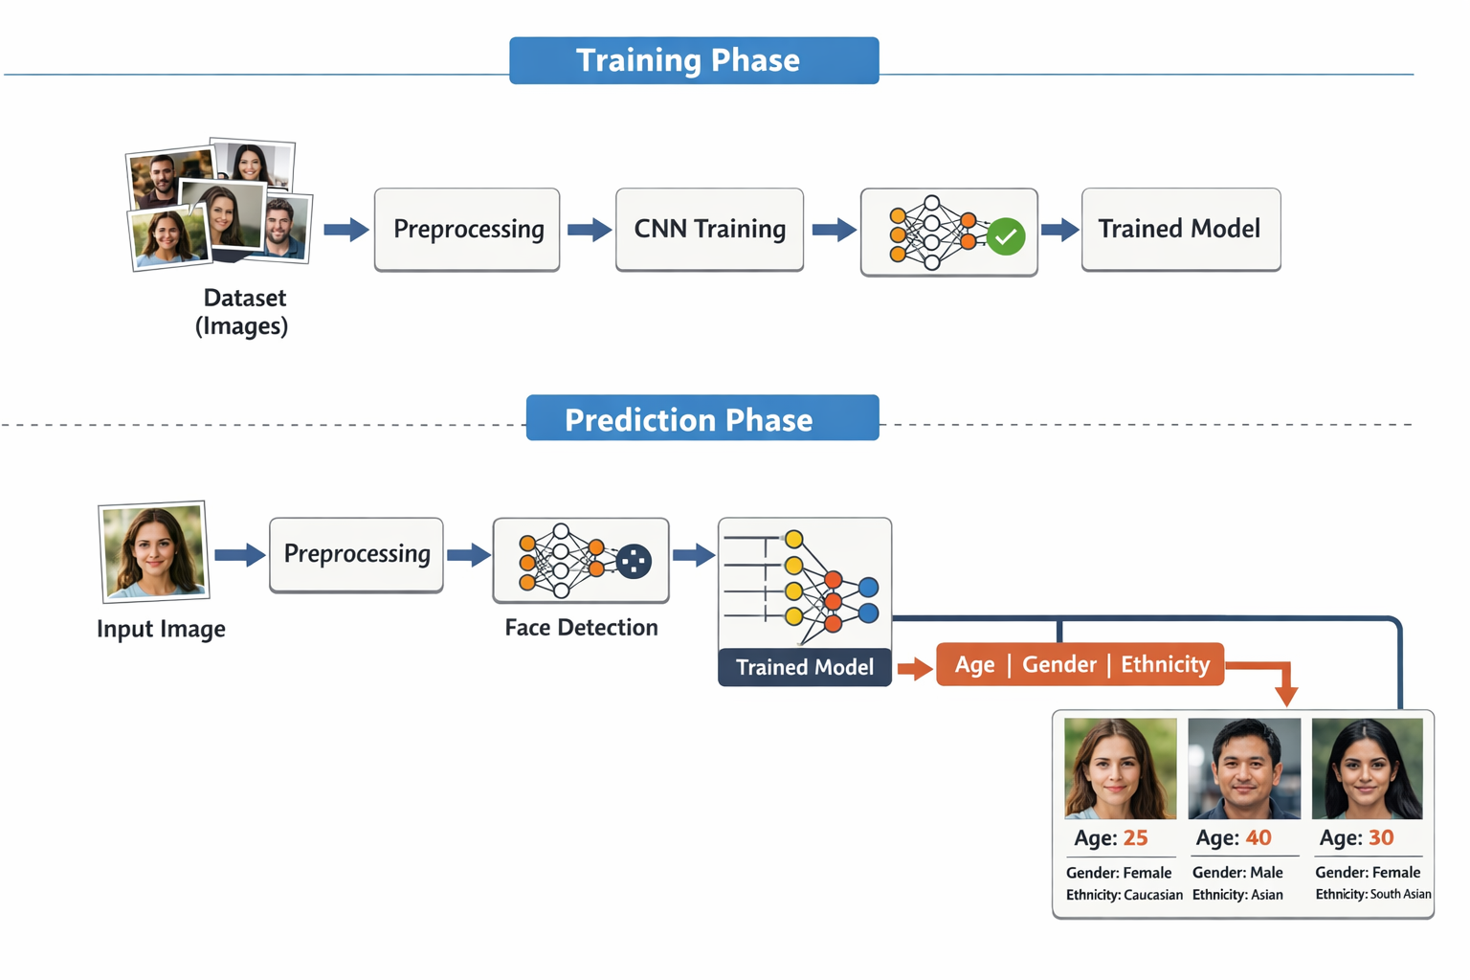
ARCHITECTURE DIAGRAM

Slide 12
In this system, multiple images are first used to train a model using techniques from Artificial Intelligence and Computer Vision.
nce trained, the model processes input images one by one. Each image is preprocessed, analyzed, and passed through the trained model to predict age, gender, and ethnicity (region). The results are then displayed as output.

Slide 13
MODULES
Data Collection Module
Collects facial image datasets with age, gender, and ethnicity labels.
Preprocessing Module
Performs image resizing, normalization, and face detection.
Model Training Module
Trains a CNN model using the dataset to learn facial features.
Feature Extraction Module
Extracts important features from images using the trained model.
Prediction Module
Predicts age, gender, and ethnicity for input images.
Output Module
Displays the final predicted results to the user.

Slide 14
IMPLEMENTATION
import tensorflow as tf
import cv2
import os
import glob
import sys
import numpy as np
import pandas as pd
import matplotlib.pyplot as plt
from matplotlib.patches import Rectangle
from matplotlib.patches import Circle
from sklearn.model_selection import train_test_split

Slide 15
from PIL import Image
import random
import tensorflow.keras.backend as K
from tensorflow.keras.layers import Input
from tensorflow.keras.models import load_model
from tensorflow.keras.layers import Conv2D,MaxPooling2D, Flatten, Dense, Dropout, BatchNormalization
from tensorflow.keras.callbacks import ModelCheckpoint, EarlyStopping, ReduceLROnPlateau
from tensorflow.keras.optimizers import Adam
from tensorflow.keras.models import Model
from tensorflow.keras.utils import plot_model
import seaborn as sns
from sklearn.metrics import confusion_matrix

Slide 16
IMPLEMENTATION
Programming Language: Python
Libraries: TensorFlow / Keras / PyTorch
Image Processing Tool: OpenCV
Dataset: Facial image dataset (with age, gender, ethnicity labels)
Model: Convolutional Neural Network (CNN)
Preprocessing: Resizing, normalization, face detection
Training: Model trained on multiple images
Testing: Images given one by one for prediction
Output: Age, Gender, Ethnicity prediction
Based on Artificial Intelligence and Computer Vision

Slide 17
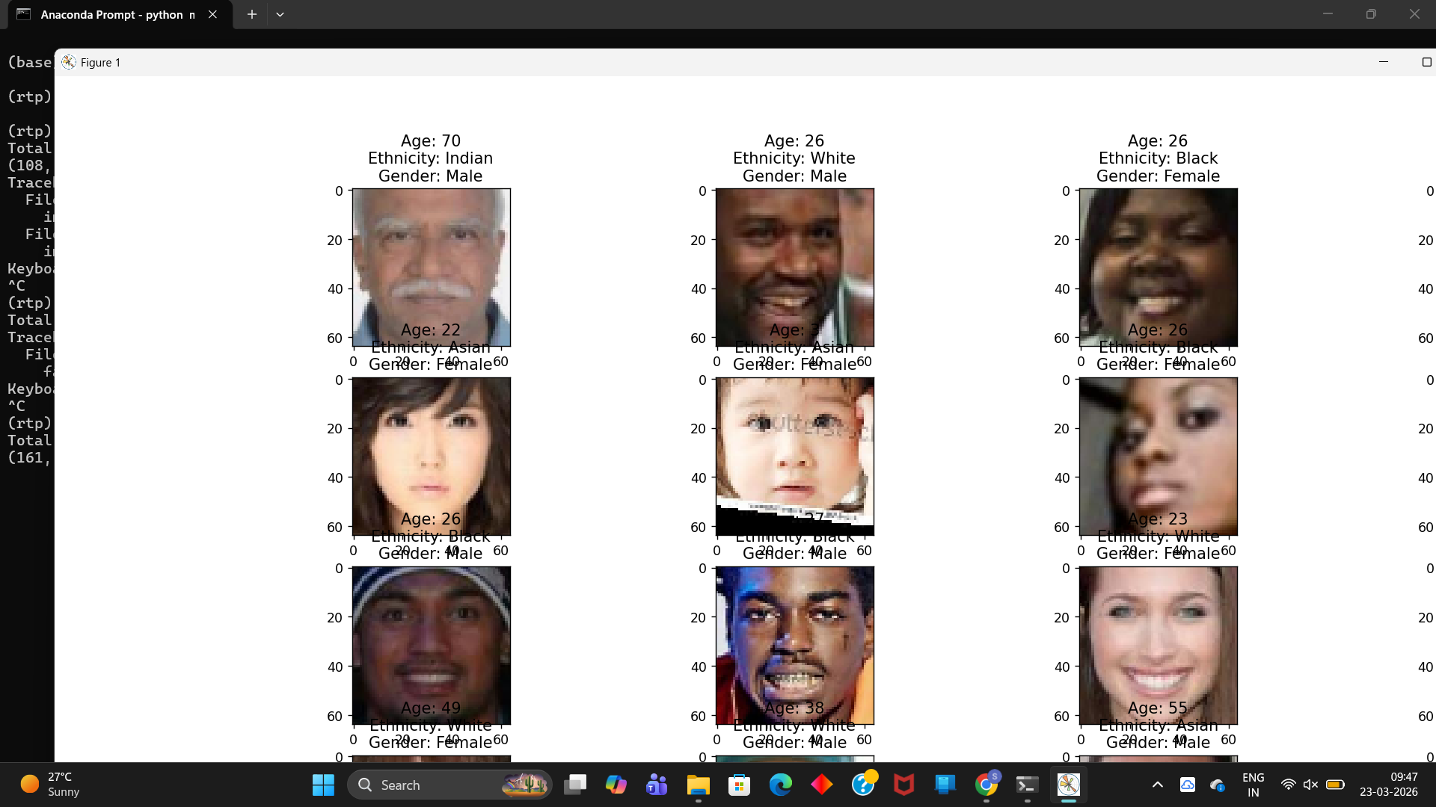
SCREENSHOTS(OUTPUT)

Slide 18
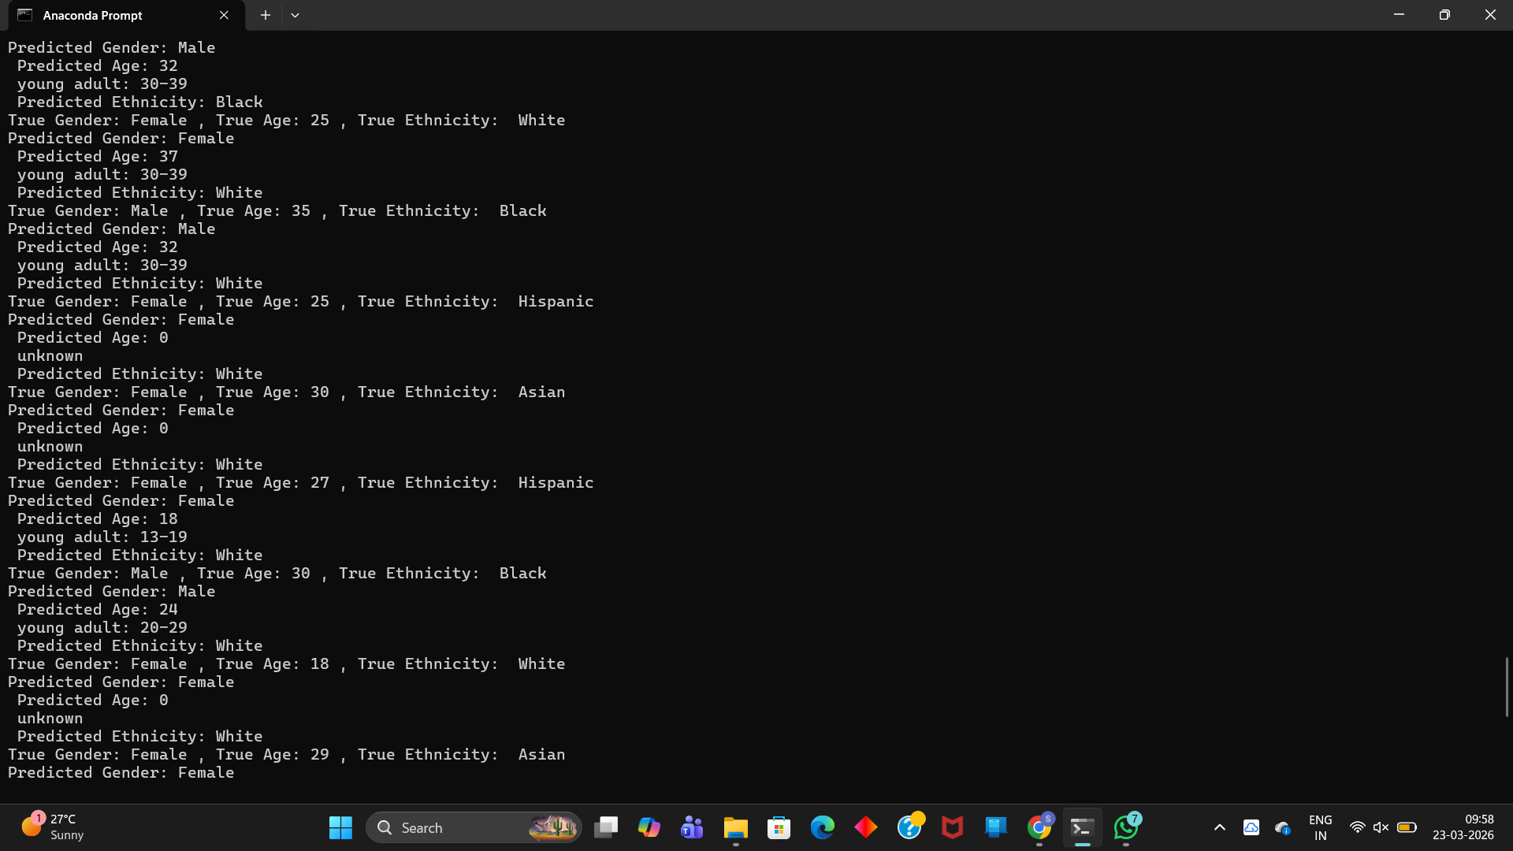

Slide 19
TESTING
The system is tested by providing facial images as input to evaluate its performance in predicting age, gender, and ethnicity. Each image is preprocessed and passed through the trained model, and the predicted results are compared with actual values to check accuracy. Different images with variations in lighting, pose, and quality are used to ensure reliability. The testing process, based on Artificial Intelligence and Computer Vision, helps in identifying errors and improving the overall performance of the system.

Slide 20
Types of Testing Used
Unit Testing – Testing individual modules like preprocessing and prediction
Integration Testing – Checking how all modules work together
Performance Testing – Evaluating accuracy and speed of the model
Validation Testing – Comparing predicted results with actual data

Slide 21
CONCLUSION
The project successfully demonstrates the use of Artificial Intelligence and Computer Vision in predicting age, gender, and ethnicity from facial images. By using deep learning techniques, the system is able to analyze facial features and provide accurate predictions. Although the model performs well, challenges such as data bias and image quality can affect results. Overall, the project highlights the effectiveness and real-world applications of automated demographic prediction systems.

Slide 22
THANK YOU
PRESENTED BY
B.MYTHILI – 23R01A05K7
B.JYOSTNA PRIYA – 23R01A05L2
M.SADGUNA – 23R01A05P1
UNDER THE GUIDANCE OF
Mrs. A. TEJASWI

